Slide 1

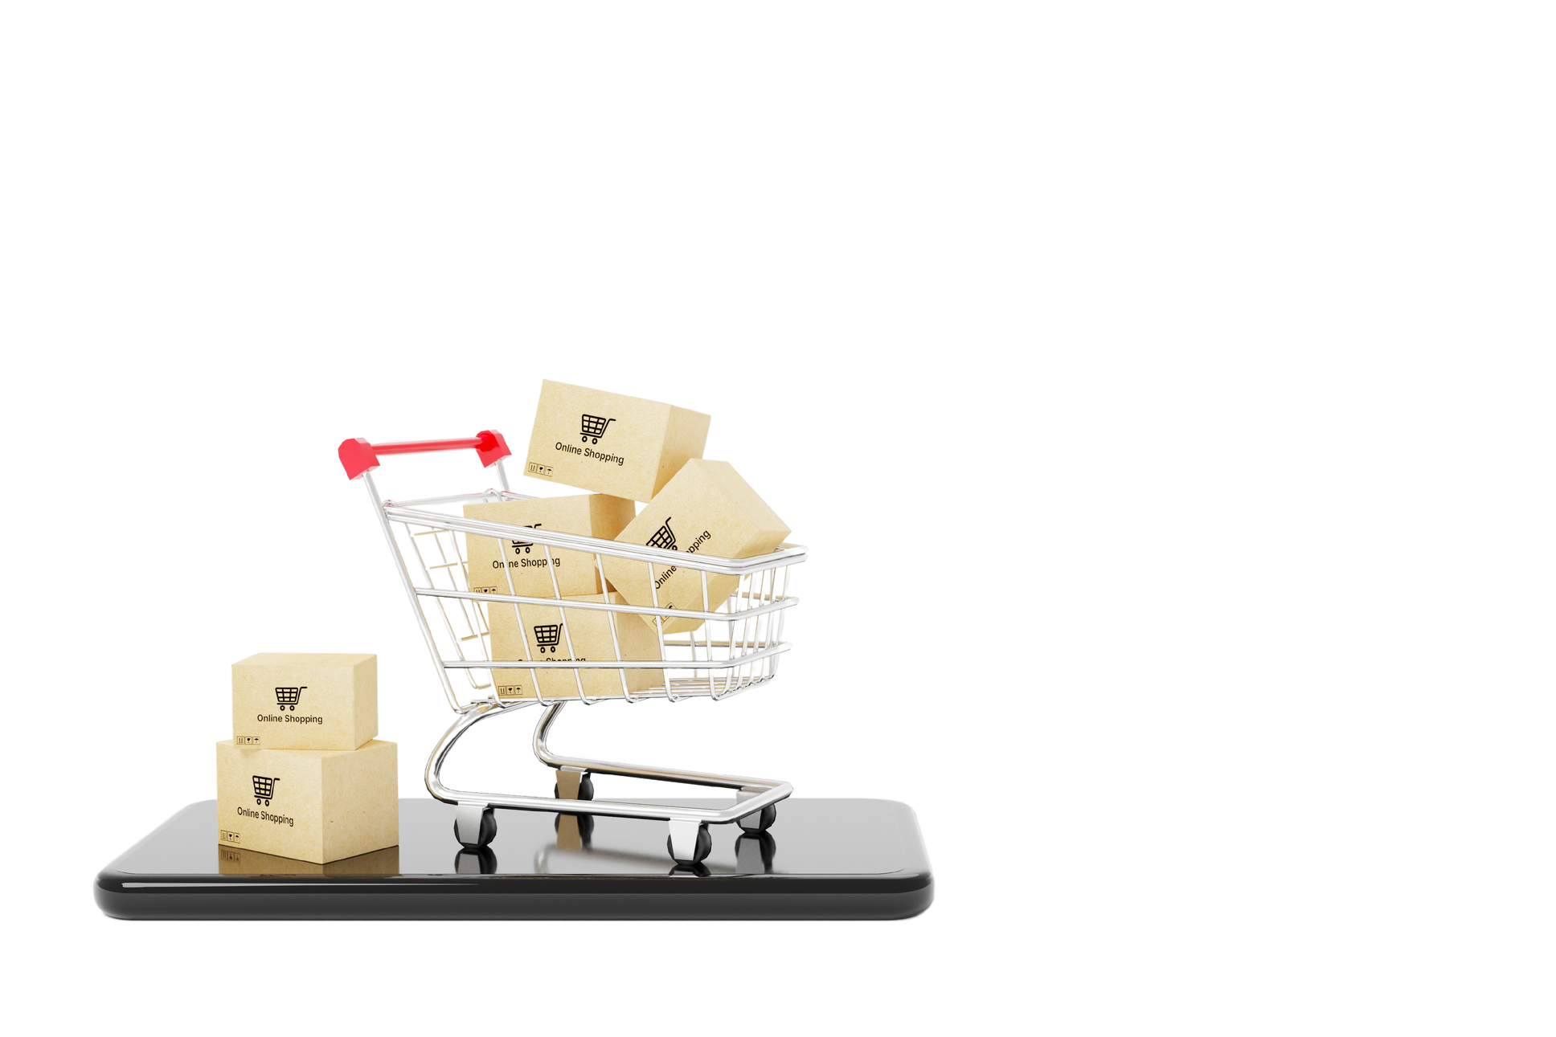
CODEBASICS RESUME PROJECT CHALLENGE
CONSUMER GOODS
ANALYTICS

Slide 2



ABOUT COMPANY
Atliq Hardwares is one of the leading computer hardware producers in India and well expanded in other countries too.

Slide 3
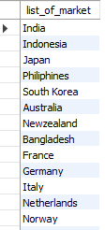
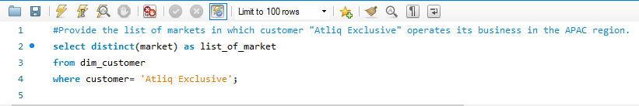
01
list of markets in which customer "Atliq Exclusive" operates its business in the APAC region.
SQL QUERY AND OUTPUT

Slide 4
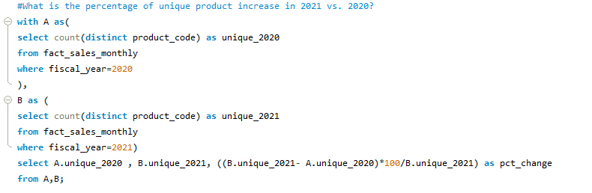
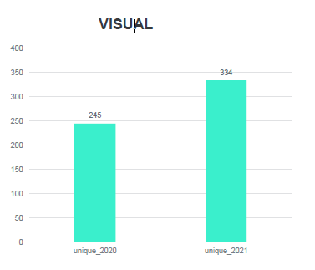

02
The percentage of unique products increase in 2021 vs. 2020?
SQL QUERY AND OUTPUT

Slide 5
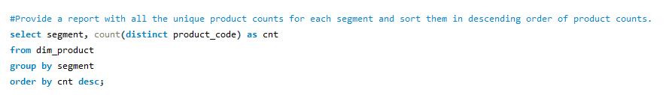
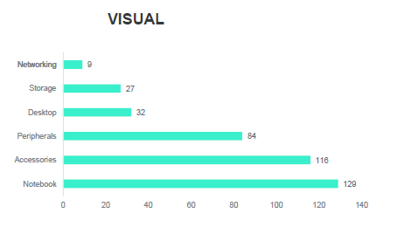
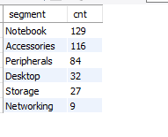
03
Report with all the unique product counts for each segment and sort them in descending order of product counts.
SQL QUERY AND OUTPUT

Slide 6
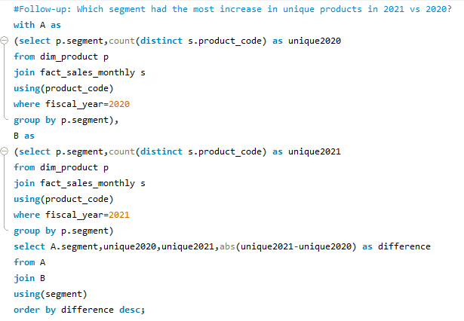
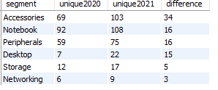
04
Which segment had the most increase in unique products in 2021 vs 2020?
SQL QUERY AND OUTPUT

Slide 7
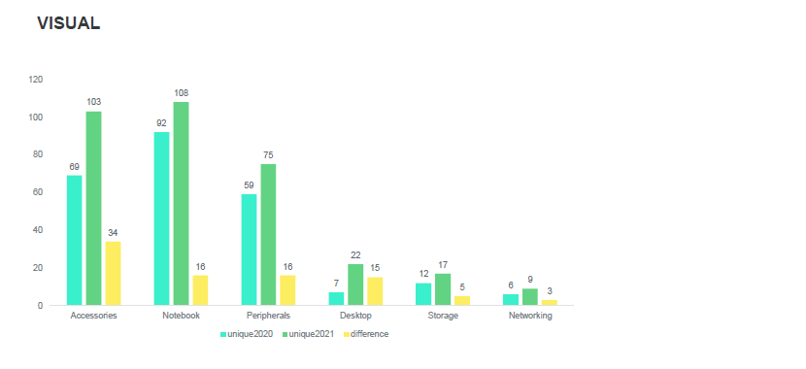

Slide 8
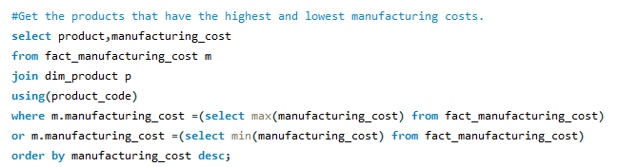

05
The products that have the highest and lowest manufacturing costs.
SQL QUERY AND OUTPUT

Slide 9
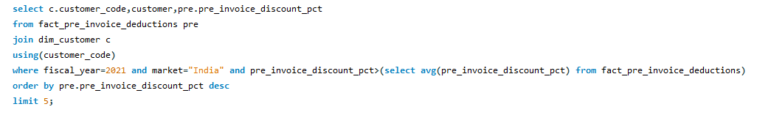
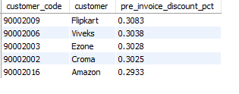
06
A report which contains the top 5 customers who received an average high pre_invoice_discount_pct for the fiscal year 2021 and in the Indian market.
SQL QUERY AND OUTPUT

Slide 10
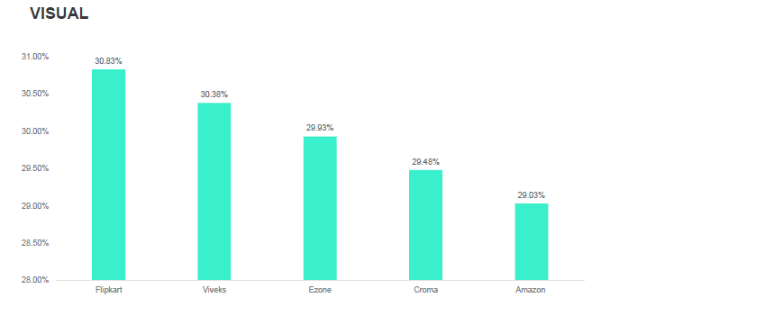

Slide 11
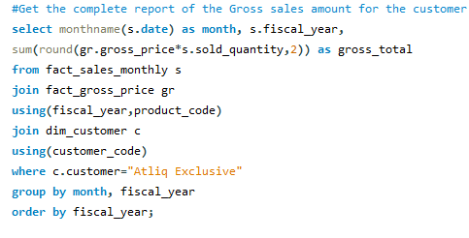
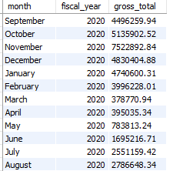
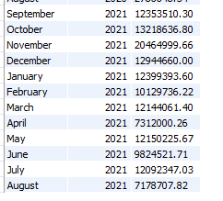
07
A report of the Gross sales amount for the customer “Atliq Exclusive” for each month
SQL QUERY AND OUTPUT

Slide 12
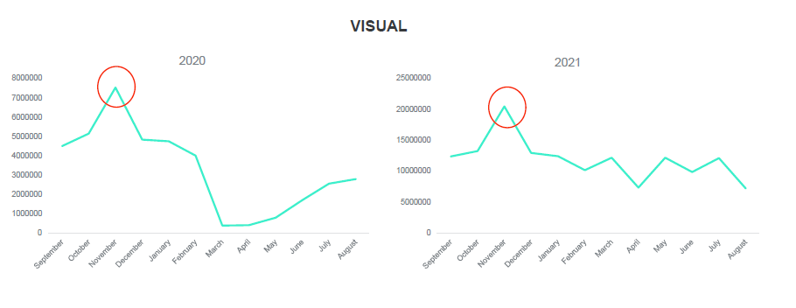

Slide 13
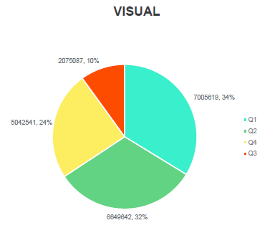
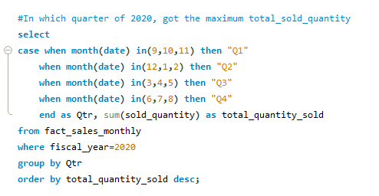

08
Quarter of 2020, got the maximum total_sold_quantity
SQL QUERY AND OUTPUT

Slide 14
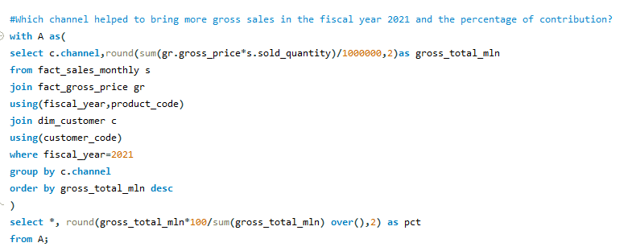
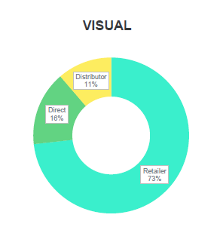


Slide 15
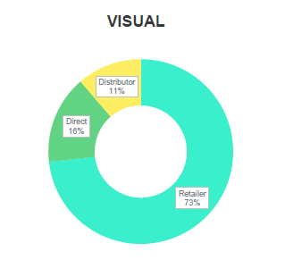
09
Which channel helped to bring more gross sales in the fiscal year 2021 and the percentage of contribution?
SQL QUERY AND OUTPUT

Slide 16
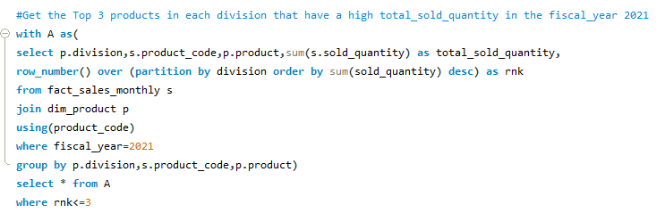
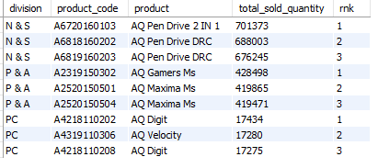
10
The Top 3 products in each division that have a high total_sold_quantity in the fiscal_year 2021?
SQL QUERY AND OUTPUT

Slide 17
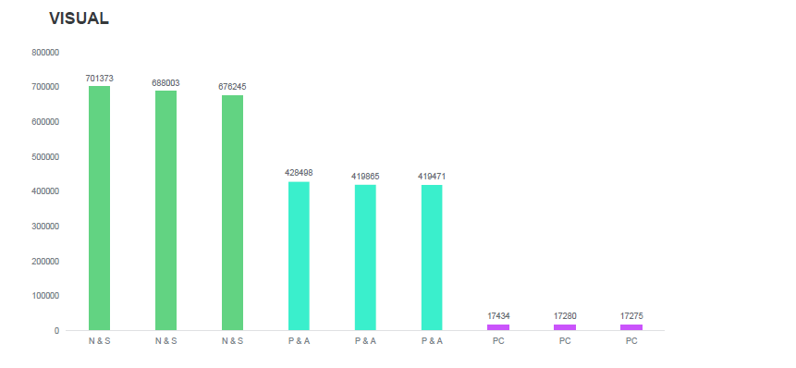

Slide 18
INSIGHTS GENERATED:
Our unique product experienced a remarkable 36.33% increase in sales during the fiscal year 2021 compared to the previous year.
The top-selling product in our portfolio is the Notebook, while the Networking product line shows the lowest sales figures
Among our product manufacturing costs, Desktops have the highest expenditure, whereas Mouse production costs are the lowest.
During FY2021, Flipkart made the highest customer contribution with an impressive 30.83%30.83%, whereas Amazon's customer contribution was at its lowest, with a figure of 29.33%
During the lowest sales period, which was in March 2020, we achieved sales of 2.8 million units. However, in November
2021, we experienced our highest sales contribution with a record of 32.2 million units sold.

